Slide 1

CSE- 321
Software Engineering
Lecture : 13 Software design
Fahad Ahmed
Lecturer, Dept. of CSE
E-mail: fahadahmed@uap-bd.edu

Slide 2


Distributed Systems Architectures

Slide 3
Distributed Systems Architectures
Client-Server Architecture
Broker Architectural Style : CORBA
Service-Oriented Architecture (SOA)

Slide 4
Distributed Architecture
A distributed system is "a collection of independent computers that appears to the user as a single coherent system." Information processing is distributed over several computers rather than confined to a single machine.
Virtually all large computer-based systems are now distributed systems.
Distributed software engineering is therefore very important for enterprise computing systems.

Slide 5
Distributed Architecture
A distributed system can be demonstrated by the client-server architecture which forms the base for multi-tier architectures; alternatives are the broker architecture such as CORBA, and the Service-Oriented Architecture (SOA).
There are several technology frameworks to support distributed architectures, including .NET, J2EE, CORBA, .NET Web services, AXIS Java Web services, and Globus Grid services.

Slide 6
Distributed Architecture
Middleware is an infrastructure that appropriately supports the development and execution of distributed applications.
It provides a buffer between the applications and the network.
It sits in the middle of system and manages or supports the different components of a distributed system.
Examples are transaction processing monitors, data convertors and communication controllers etc.

Slide 7
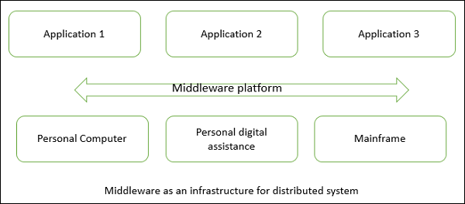
Distributed System

Slide 8
Distributed System
Advantages
Resource sharing − Sharing of hardware and software resources.
Openness − Flexibility of using hardware and software of different vendors.
Concurrency − Concurrent processing to enhance performance.
Scalability − Increased throughput by adding new resources.
Fault tolerance − The ability to continue in operation after a fault has occurred.
Disadvantages
Complexity − They are more complex than centralized systems.
Security − More susceptible to external attack.
Manageability − More effort required for system management.
Unpredictability − Unpredictable responses depending on the system organization and network load.

Slide 9
Centralized System vs. Distributed System
Criteria | Centralized system | Distributed System
Economics | Low | High
Availability | Low | High
Complexity | Low | High
Consistency | Simple | High
Scalability | Poor | Good
Technology | Homogeneous | Heterogeneous
Security | High | Low

Slide 10
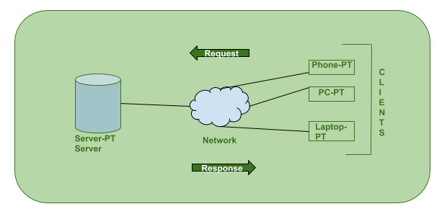
Client-Server Architecture
The client-server architecture is the most common distributed system architecture which decomposes the system into two major subsystems or logical processes −
Client − This is the first process that issues a request to the second process i.e. the server.
Server − This is the second process that receives the request, carries it out, and sends a reply to the client.

Slide 11
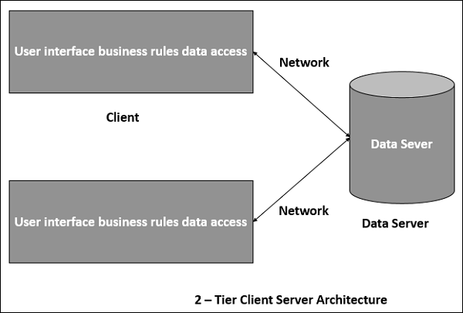
Client-Server Architecture

Slide 12
Client-Server Architecture
How the Client-Server Model (web browsers) works ?
User enters the URL(Uniform Resource Locator) of the website or file. The Browser then requests the DNS(DOMAIN NAME SYSTEM) Server.
DNS Server lookup for the address of the WEB Server.
DNS Server responds with the IP address of the WEB Server.
Browser sends over an HTTP/HTTPS request to WEB Server’s IP (provided by DNS server).
Server sends over the necessary files of the website.
Browser then renders the files and the website is displayed. This rendering is done with the help of DOM (Document Object Model) interpreter, CSS interpreter and JS Engine collectively known as the JIT or (Just in Time) Compilers.

Slide 13
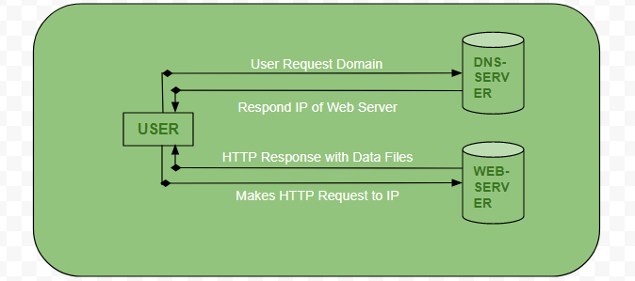
Client-Server Architecture
How the Client-Server Model (web browsers) works ?

Slide 14
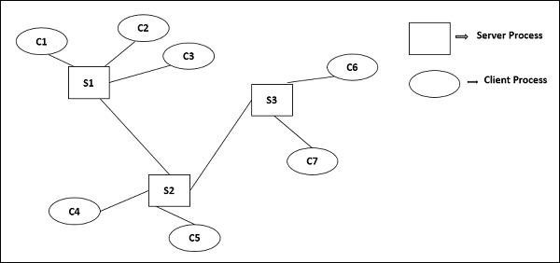
Multi-Tier Architecture (n-tier Architecture)
Multi-tier architecture is a client–server architecture in which the functions such as presentation, application processing (Business Logic, Logic Tier, or Middle Tier)
, and data management are physically separated.
** 3-Tier Architecture, 2-Tier Architecture

Slide 15
Client-Server Architecture
Advantages
Distribution of data is straightforward;
Makes effective use of networked systems. May require cheaper hardware;
Easy to add new servers or upgrade existing servers.
Disadvantages
No shared data model so sub-systems use different data organisation. Data interchange may be inefficient;
Redundant management in each server;
No central register of names and services - it may be hard to find out what servers and services are available.

Slide 16
Client-Server Architecture
Here are some real-life situations that this would be useful for:
Enterprise resource planning (ERP) system
SAP (sap.com).
Oracle Business Suite (oracle.com).
Microsoft Dynamics (microsoft.com.
Infor (infor.com).
Epicor (epicor.com).

Slide 17
Case-Study: Solving a Business Problem With Client-Server Architecture
IrisGold is a gold mining company. Here are some quick facts:
IrisGold operates on three continents, with more than 21,000 employees.
The company’s mines are mostly located in remote places like the Amazonas in Brazil, the Andes mountain range, the Ural mountains in Russia, and eastern South Africa.
The company is selecting an Enterprise Resource Planning (ERP) system package. How does this inform your decision?

Slide 18
Case-Study: Solving a Business Problem With Client-Server Architecture
What’s the Business Problem?
IrisGold wants to deploy and operate its new ERP package securely. But they have two main constraints:
Its users are in remote places in the world with different kinds of devices (laptops, notebooks, phones, tablets).
Client devices must be light: they must be a simple notebook computer, tablet, or phone with few processing and storage capabilities, able to communicate to a remote server.

Slide 19
Case-Study: Solving a Business Problem With Client-Server Architecture
Let’s start with the facts!
We know that users are scattered over the world and use different devices that need to be lightweight.
We know that users have deficient infrastructure capabilities and work in remote places.
Clients need only to be able to connect with a central server.
The ERP system installed in the central server must cover all the business rules. In essence, it must manage all modules for all countries internally, and it must answer client requests by communicating with a central database.

Slide 20
Case-Study: Solving a Business Problem With Client-Server Architecture
So to sum up:
We know that users are scattered over the world and use different devices that need to be lightweight.
We know that users have deficient infrastructure capabilities and work in remote places.
Clients need only to be able to connect with a central server.
The ERP system installed in the central server must cover all the business rules. In essence, it must manage all modules for all countries internally, and it must answer client requests by communicating with a central database.

Slide 21
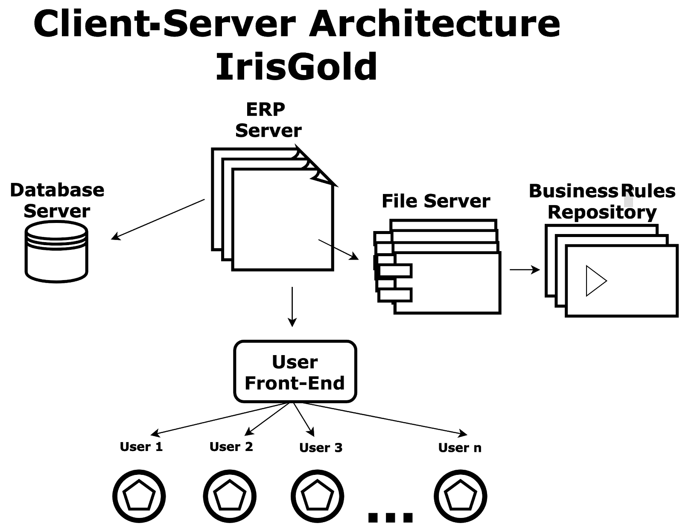
Case-Study: Solving a Business Problem With Client-Server Architecture
What's the Solution?
All heavy processing is done at IrisGold’s headquarters. Clients are thin; that’s why they are called “thin clients.” They do not process or store large amounts of data. They just speak with the server.
Response Requests
Send Requests

Slide 22
Case-Study: Solving a Business Problem With Client-Server Architecture
Front-End: This is the piece of software that interacts with ERP users, even if they are in different countries.
ERP server: This is the server where the ERP software is installed.
File server: The ERP server requests files from the file server to fulfill user requests. Examples: an invoice printed in PDF format, a report, a data file that the user needs. It is good practice to install a file server when the application has many users that read, update, or write files frequently.
Business rules repository: A repository of business procedures, methods, and regulations for every country (all different), to make the ERP work according to each country's needs. This repository is often separated from the software to make customizations more agile and secure. It is a good practice introduced by ERPs in the '90s that has spread over many kinds of non-ERP applications.
Database server: This server contains the tables, indexes, and data managed by the ERP system. Examples: customer table, provider table, invoice list, stock tables, product IDs, etc.

Slide 23

Thanks to All

